Slide 1
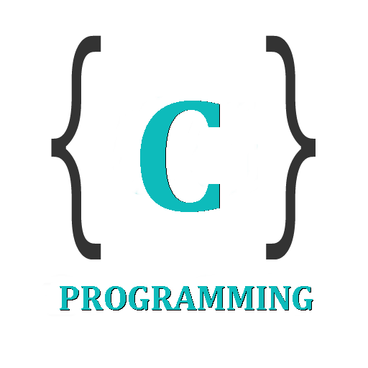

IT 105: Introduction to Programming
Dr. Manish Khare
Dr. Saurabh Tiwari
Lecture 7

Slide 2
More complex Decision Making
  If a get good marks in my final year and if my GRE and TOFEL scores are good and if I get good recommendations or of I do not get a job with good prospects and if my family conditions permit me, then I would think of doing MS in US.
  How can such complex decision making be implemented in C?

Slide 3
Use of Logical Operators
C allows usage of three logical operators, namely, &&, || and !.
  These are to be read as:
    ‘AND’ &&
    ‘OR’ ||
    ‘NOT’ !
Remember: Don’t use the single symbol | and &. These have a different meaning. They are bitwise operators.

Slide 4
Use of operators && and ||
Example:
The marks obtained by a student in 5 different subjects are input through the keyboard. The student gets a division as per the following rules:
  Percentage above or equal to 60 - First division
  Percentage between 50 and 59 - Second division
  Percentage between 40 and 49 - Third division
  Percentage less than 40 - Fail
Write a program to calculate the division obtained by the student.

Slide 5
Solution Method 1
/* Method – I */
main( )
{
int m1, m2, m3, m4, m5, per ;
printf ( "Enter marks in five subjects " ) ;
scanf ( "%d %d %d %d %d", &m1, &m2, &m3, &m4, &m5 ) ;
per = ( m1 + m2 + m3 + m4 + m5 ) / 5 ;

Slide 6
Solution Method 1
if ( per >= 60 )
printf ( "First division ") ;
else
{
if ( per >= 50 )
printf ( "Second division" ) ;
else
{
if ( per >= 40 )
printf ( "Third division" ) ;
else
printf ( "Fail" ) ;
}
}
} /* main */

Slide 7
Use of ‘Logical operators’
/* Method – II */
main( )
{
int m1, m2, m3, m4, m5, per ;
printf ( "Enter marks in five subjects " ) ;
scanf ( "%d %d %d %d %d", &m1, &m2, &m3, &m4, &m5 ) ;
per = ( m1 + m2 + m3 + m4 + m5 ) / 5 ;

Slide 8
Solution Method 2
if ( per >= 60 )
printf ( "First division" ) ;
if ( ( per >= 50 ) && ( per < 60 ) )
printf ( "Second division" ) ;
if ( ( per >= 40 ) && ( per < 50 ) )
printf ( "Third division" ) ;
if ( per < 40 )
printf ( "Fail" ) ;
} /* main */

Slide 9
The else if clause
if ( per >= 60 )
printf ( "First division ") ;
else
{
if ( per >= 50 )
printf ( "Second division" ) ;
else
{
if ( per >= 40 )
printf("Third division");
else
printf ( "Fail" ) ;
}
}
/* else if ladder demo */
main( )
{
int m1, m2, m3, m4, m5, per ;
per = ( m1+ m2 + m3 + m4+ m5 ) /5;
if ( per >= 60 )
printf ( "First division" ) ;
else if ( per >= 50 )
printf ("Second division") ;
else if ( per >= 40 )
printf ( "Third division" ) ;
else
printf ( "fail" ) ;
}

Slide 10
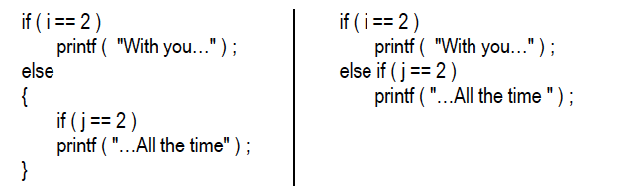
The else if clause

Slide 11
Example – Logical Operators
Example:
A company insures its drivers in the following cases:
− If the driver is married.
− If the driver is unmarried, male & above 30 years of age.
− If the driver is unmarried, female & above 25 years of age.
In all other cases the driver is not insured. If the marital status, sex and age of the driver are the inputs, write a program to determine whether the driver is to be insured or not.
https://ideone.com/sh7j2i

Slide 12
Example – Logical Operators
/* Insurance of driver - using logical operators */
main( )
{
char sex, ms ;
int age ;
printf ( "Enter age, sex, marital status " ) ;
scanf ( "%d %c %c" &age, &sex, &ms ) ;
if ( ( ms == 'M') || ( ms == 'U' && sex == 'M' && age > 30 ) || ( ms == 'U' && sex == 'F' && age > 25 ) )
printf ( "Driver is insured" ) ;
else
printf ( "Driver is not insured" ) ;
}

Slide 13
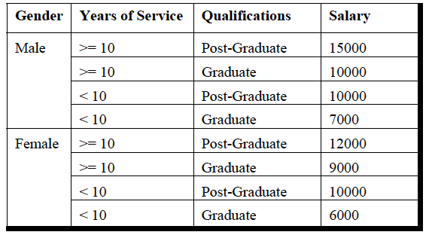
Example – Logical Operators
https://ideone.com/BH7NhK
Write a program to calculate the salary as per the following table:

Slide 14
The ! Operator
This operator reverses the result of the expression it operates on.
  if the expression evaluates to a non-zero value, then applying ! operator to it results into a 0. Vice versa
  if the expression evaluates to zero then on applying ! operator to it makes it 1, a non-zero value.
  ! ( y < 10 )
    “not y less than 10”
    y >= 10.
if (!flag) is same as if ( flag == 0 )

Slide 15
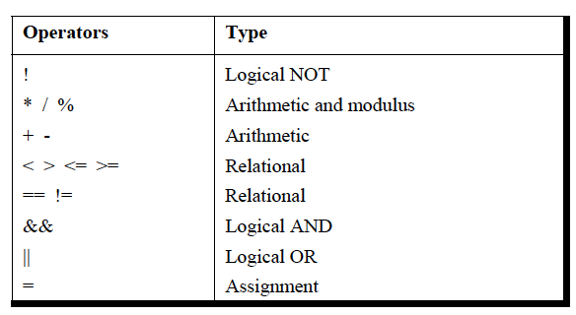
Hierarchy of Operators

Slide 16
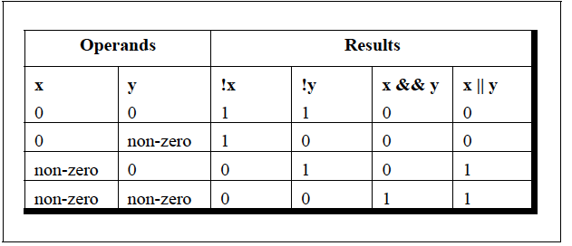
Summarize Logical Operators

Slide 17
The Conditional Operators
Also known as ternary operator
A short form of if-then-else
  expression 1 ? expression 2 : expression 3
    “if expression 1 is true (that is, if its value is non-zero), then the value returned will be expression 2, otherwise the value returned will be expression 3”.
int x, y ;
scanf ( "%d", &x ) ;
y = ( x > 5 ? 3 : 4 ) ;
if ( x > 5 )
y = 3 ;
else
y = 4 ;

Slide 18
More on Conditional Operators
char a ;
int y ;
scanf ( "%c", &a ) ;
y = ( a >= 65 && a <= 90 ? 1 : 0 ) ;
1 would be assigned to y if a >=65 && a <=90 evaluates to true, otherwise 0 would be assigned.
It’s not necessary that the conditional operators should be used only in arithmetic statements.
int i ;
scanf ( "%d", &i ) ;
( i == 1 ? printf ( "Amit" ) : printf ( "All and sundry" ) ) ;

Slide 19
More on Conditional Operators
The conditional operators can be nested as shown below.
int big, a, b, c ;
big = ( a > b ? ( a > c ? 3: 4 ) : ( b > c ? 6: 8 ) ) ;
Check the following statement:
a > b ? g = a : g = b ;
Error: ‘Lvalue Required’.
Can be removed by adding parenthesis
  a > b ? g = a : ( g = b ) ;
In absence of parentheses the compiler believes that b is being assigned to the result of the expression to the left of second =. Hence it reports an error.

Slide 20
Exercise: Guess the Output
main( )
{
int i = 4, z = 12 ;
if ( i = 5 || z > 50 )
printf ( "\nDean of students affairs" ) ;
else
printf ( "\nDosa" ) ;
}

Slide 21
Exercise: Guess the Output
main( )
{
int i = 4, j = -1, k = 0, w, x, y, z ;
w = i || j || k ;
x = i && j && k ;
y = i || j && k ;
z = i && j || k ;
printf ( "\nw = %d x = %d y = %d z = %d", w, x, y, z ) ;
}
Notes:
1, 0, 1, 1

Slide 22
Exercise: Guess the Output
main( )
{
int x = 20 , y = 40 , z = 45 ;
if ( x > y && x > z )
printf( "x is big" ) ;
else if ( y > x && y > z )
printf( "y is big" ) ;
else if ( z > x && z > y )
printf( "z is big" ) ;
}

Slide 23
Exercise: Guess the Output
main( )
{
char spy = 'a', password = 'z’ ;
if ( spy == 'a' or password == 'z’ )
printf ( "\nAll the birds are safe in the nest" ) ;
}

Slide 24
Exercise: Guess the Output
main( )
{
int x = 2;
if ( x == 2 && x != 0 ) ;
{
printf ( "\nHi" ) ;
printf( "\nHello" ) ;
}
else
printf( "Bye" ) ;
}

Slide 25
Exercise: Guess the Output
main( )
{
int i = 10, j ;
i >= 5 ? j = 10 : j = 15 ;
printf ( "\n%d %d", i, j ) ;
}

Slide 26
Exercise: Guess the Output
main( )
{
int a = 5 , b = 6 ;
( a == b ? printf( "%d",a) ) ;
}

